Slide 1

Wine Für dich, Für uns, Für alle
Bluberry Winery
Code Analytics
Arun & Jay
12.02.2021

Slide 2
AGENDA
02.
04.
03.
05.
Introduction
01.
What, Why our story needs to be heard
Data Collection
Data Analysis
What we found
Results - Exploratory analysis – Machine Learning Methods
Methods/Analysis Plan
Price Prediction
How we want to find the valuable insights from the data
How we want to continue to next step

Slide 3
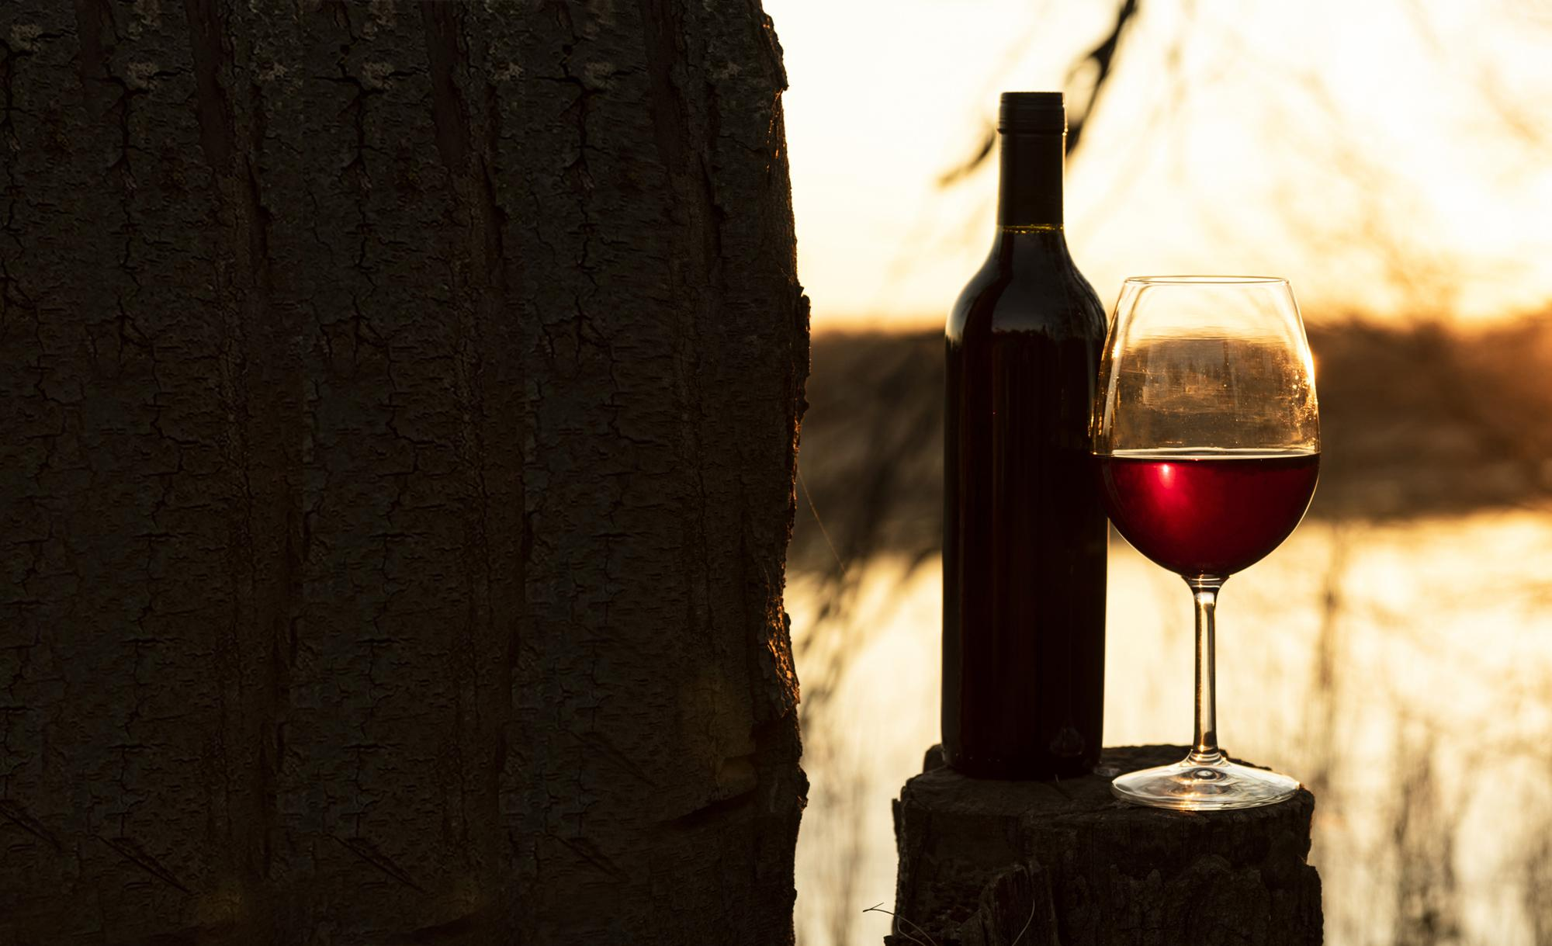
01.
Introduction
Background - Why our story needs to be heard
Goal - What we want to tell

Slide 4
Background
Blueberry Winery is one of the start-up Wine Manufacturing company in Portugal.
Blueberry Winery is trying to enter the business with a good amount of analytics & research on domain knowledge
Goal
Blueberry Winery wants to achieve the best 'Customer Satisfaction’ towards the Quality and Price
To Analyse and find the composition of factors that contribute to the quality wine

Slide 5
02.
Data Collection
What we get

Slide 6


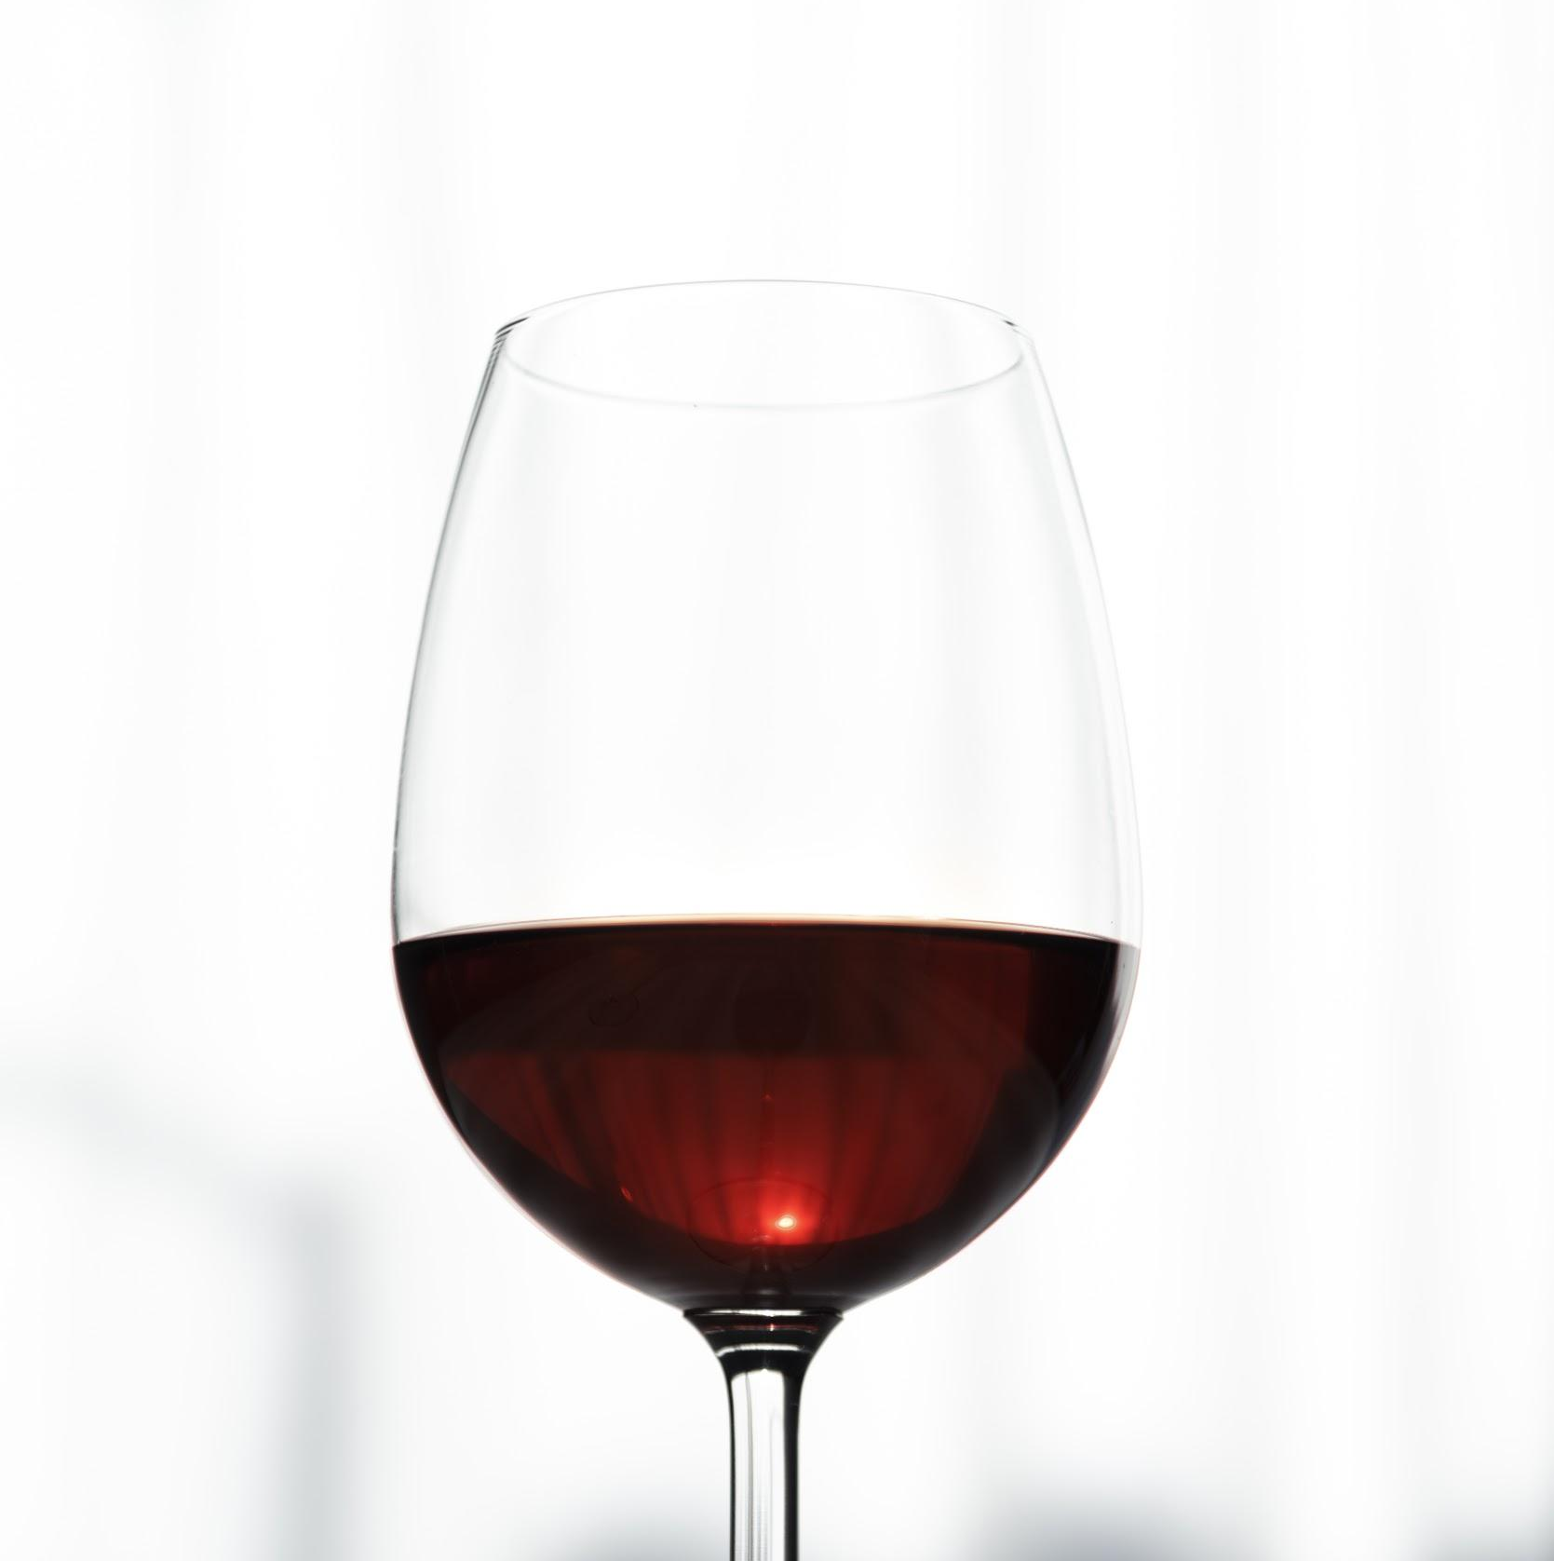
Wine Types
White Wine
Fixed Acidity
Volatile Acidity
Citric Acid
Residual Sugar
Chlorides
Free sulfur dioxide
Total sulfur dioxide
Density
pH
Sulphates
Alcohol
Quality
DataAttributes / Ingredients
Red Wine

Slide 7
03.
Methods/Analysis Plan
How we want to find the valuable insights from the data

Slide 8
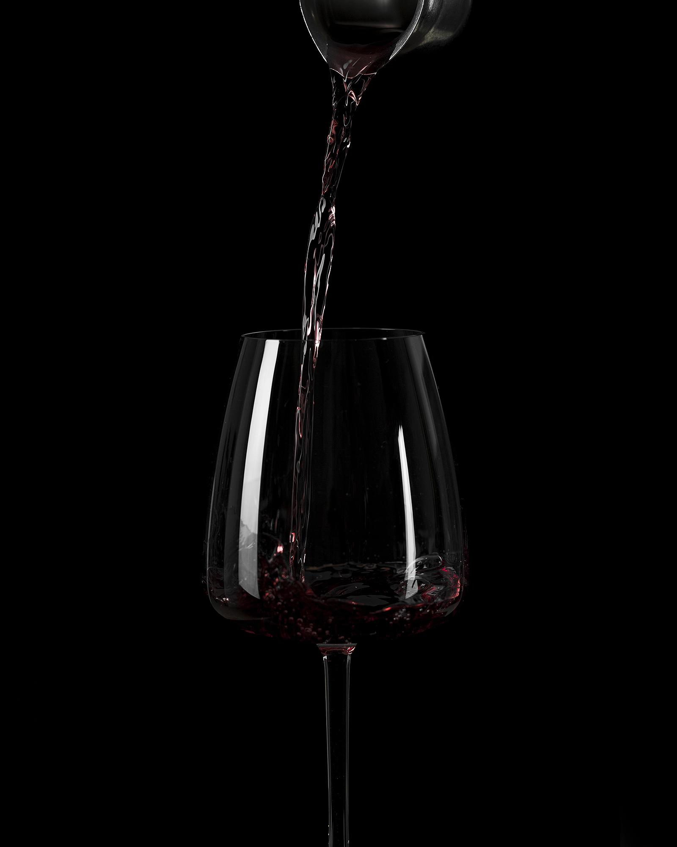

Analysis - Questions
Which factor or combination of factors affect the quality of red & white wines?
Question 1
Do the different types of wines have different factors affecting quality?
Question 2
Is there any other interesting trends that exist in other columns besides quality?
Question 3

Slide 9
Analysis - Methods
Using Exploratory Data Analysis to find the distribution of factors of each Variable
Method 1
Using Machine Learning Methods to find the Best Composition factors to contribute the quality wine
Method 2
Explore wine Quality using Machine learning method,testing
Method 3

Slide 10
04.
Exploratory Data Analysis
Results - Exploratory analysis

Slide 11
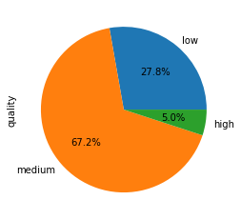
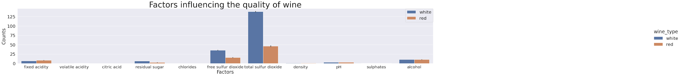
The tendency of variables in the red and white wine
Red Wine - Quality
White Wine - Quality

Slide 12
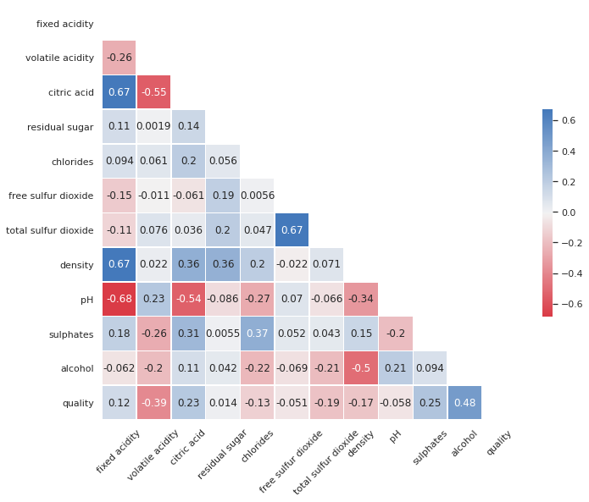
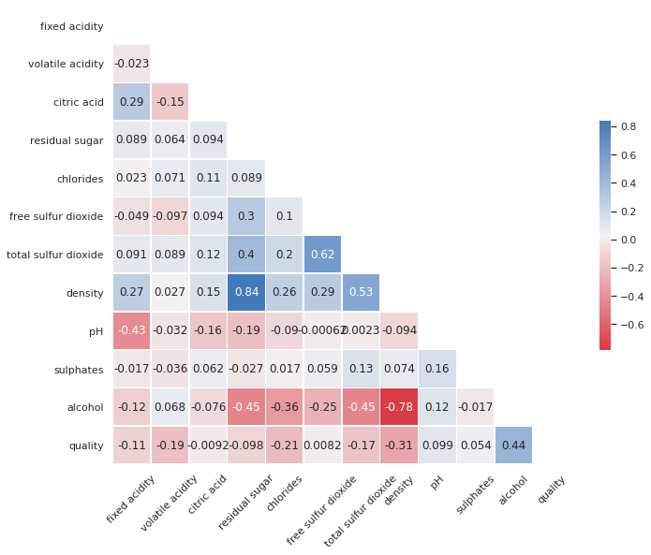
Correlation between all variables for red & white
red wine
white wine

Slide 13
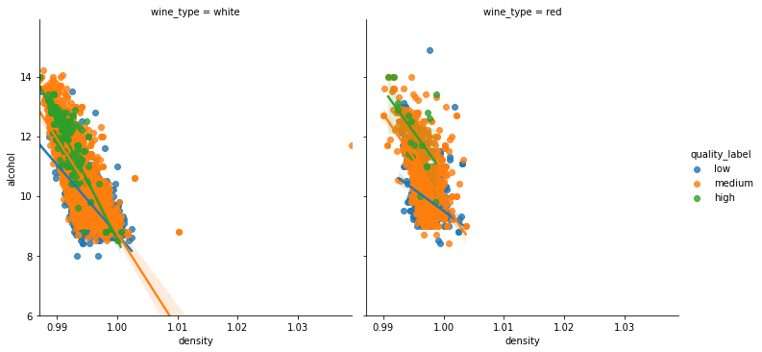
Critical factors influence the quality

Slide 14
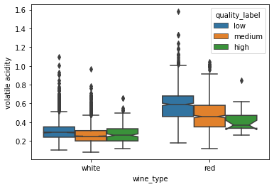
Effect of Volatile Acidity on wine quality

Slide 15
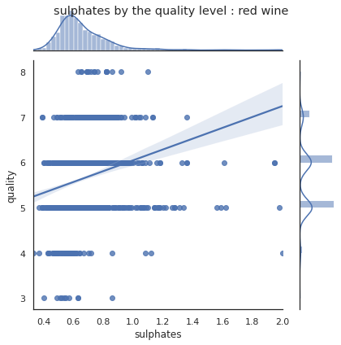
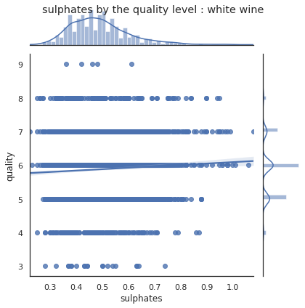
Effect of sulphates on wine quality

Slide 16
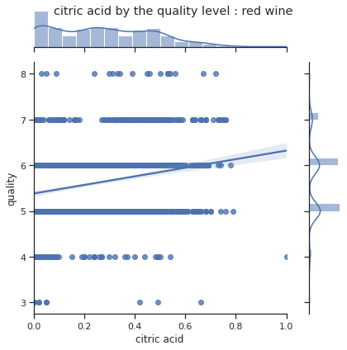
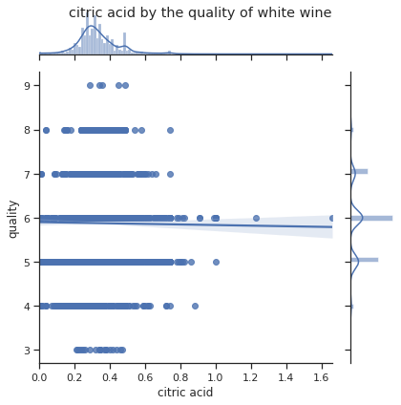
Effect of Citric Acid on wine quality

Slide 17
05.
Back to Future
How we want to continue to next step

Slide 18
Analysis
Using Exploratory Data Analysis to find the distribution of factors of each Variable
Method 1
Using Machine Learning Methods to find the Best Composition factors to contribute the quality wine
Method 2
Explore and Testing the Machine learning method which arrived
Method 3

Slide 19
Important Factors towards predicting Wine Quality

Slide 20
Machine Learning Model Scores
LR – Logistic Regression Algorithm
KNN – K Nearest Neighbor’s Algorithm
DT – Decision Tree Classifier Algorithm
RF – Random Forrest Classifier Algorithm

Slide 21
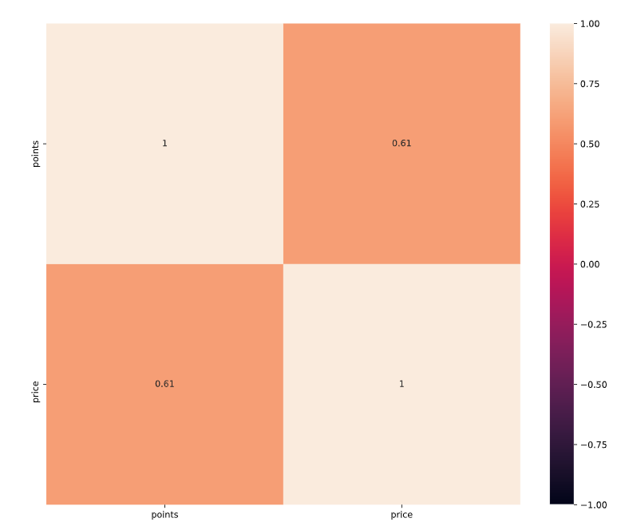
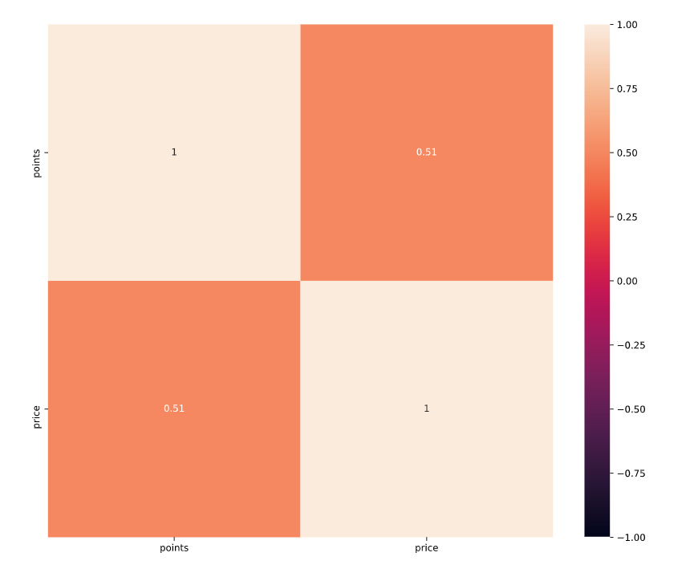
Points Vs Prize - Correlation
White Wine
Red Wine

Slide 22
Comparison of estimated price for wines in dataset1 to the price in the dataset2
LR – Logistic Regression Algorithm
KNN – K Nearest Neighbor’s Algorithm
DT – Decision Tree Classifier Algorithm
RF – Random Forrest Classifier Algorithm

Slide 23



THANKS
Do you have any questions?

Slide 24
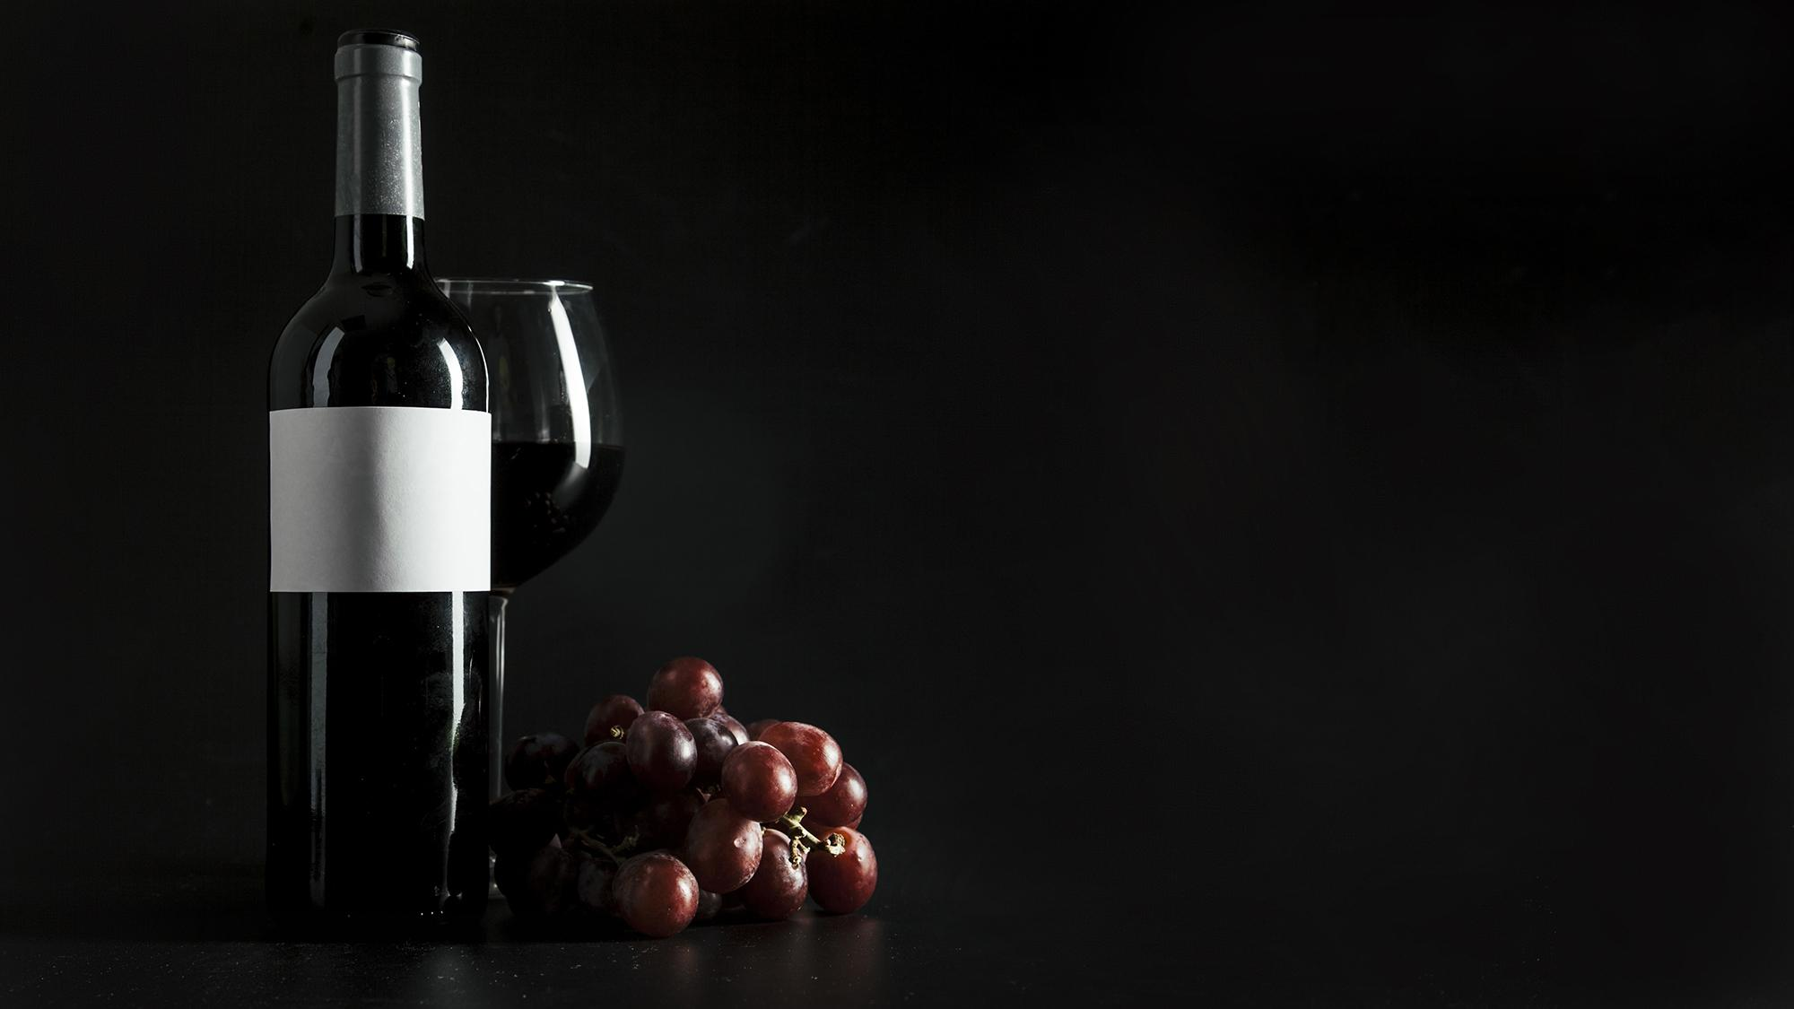
Wine
Für dich, Für uns, Für alle

